Slide 1
NXS Indices & Strategies
US ALGORITHM INDICES PLATFORM - OVERVIEW
September 2015

Slide 2
US ALGORITHM INDICES PLATFORM – OVERVIEW
Risk Premia / Smart Beta
Buy Write
Multi Assets Allocation
Investment Thematic
Implied Assets

Slide 3
US ALGORITHM INDICES PLATFORM – RISK PREMIA / SMART BETA STRATEGIES
Risk Premia / Smart Beta
Buy Write
Multi Assets Allocation
Investment Thematic
Implied Assets

Slide 4
US ALGORITHM INDICES PLATFORM – RISK PREMIA / SMART BETA: OVERVIEW
Increase the number of building blocks
5 building blocks in total as of today in the risk premia theme
Mean Reversion
Statistical arbitrage
Develop partnerships in order to leverage the Brand of major Index providers
Euronext
Wilshire
S&P
STOXX
CBOE
Solactive
Diversification across investment universes
STOXX600 and S&P 500 as of today
Russel 2000 & 3000
Diversification across Geographical areas
Europe and US (STOXX600 and S&P 500 as of today)
Asia
Diversification across Asset classes
Equity only as of today
FX
Fixed Income
Commodities
Develop a framework of risk premia based Asset Allocation
“Alternative risk premia are not new, but their greater recognition has highlited the explicit roles that they can play in investors portfolios “ (Risk Premia Investing – Mercer)

Slide 5
US ALGORITHM INDICES PLATFORM – RISK PREMIA : The building blocks
Low Volatility
Natixis Low Volatility US Equity Index
Natixis Low Volatility Europe Equity Index
Natixis Low Volatility Russel 3000 Strategy
Value
Natixis Long Value US Equity Index
Natixis Long Value Europe Equity Index
Small Cap
Natixis Small Cap US Equity Index
Natixis Small Cap Europe Equity Index
High Dividend
Natixis High Dividend US Equity Index
Natixis High Dividend Europe Equity Index
Momentum
Natixis Momentum US Equity Index
Natixis Momentum Europe Equity Index
Risk Premia
FLAGSHIPS: 5 RISK PREMIA STRATEGIES

Slide 6
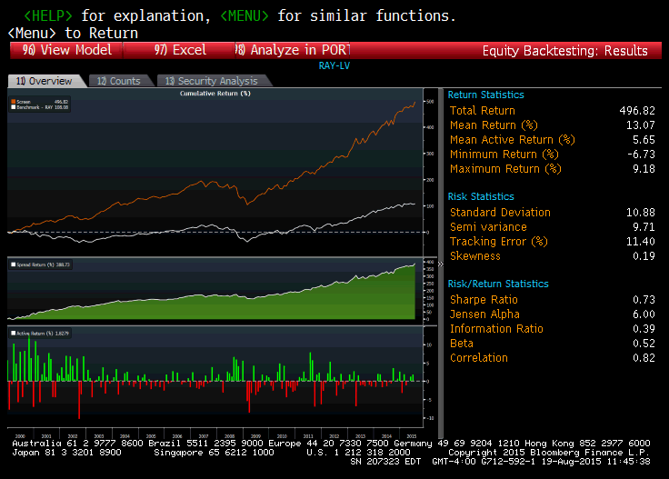
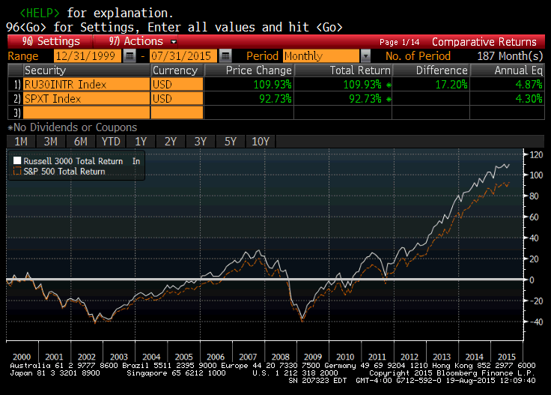
US ALGORITHM INDICES PLATFORM – RISK PREMIA : The building blocks
Investment Strategy highlights
Investment Universe:
members of Russel 3000
1st filter based ADV
2nd filter based on low volatility stocks
Ponderation : equiweighted
Rebalancing frequency: monthly
BACKTESTING: LOW VOLATILITY ON RUSSEL 3000 UNIVERSE

Slide 7
US ALGORITHM INDICES PLATFORM – SMART BETA: The building blocks
Minimum Variance
Natixis Selective Europe 30 Index
Natixis Optimum Asia
NXS Optimum Income
Equally weighted
CAC Large 60 Equal Weight Excess Return Index
S&P 500 Large Top 250 Equal Weight Excess Return Strategy
S&P 500 Large Bottom 250 Equal Weight Excess Return Strategy
Smart Beta
FLAGSHIPS

Slide 8
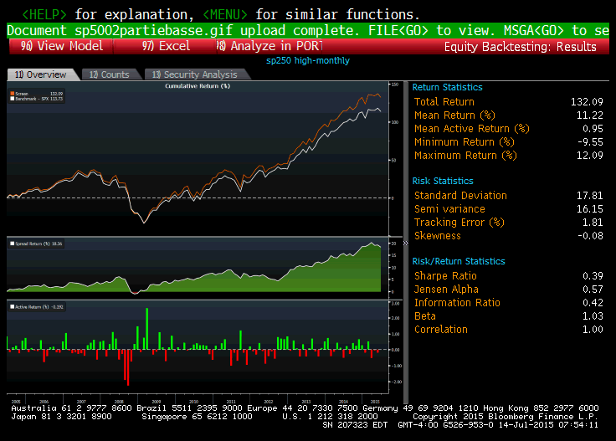
US ALGORITHM INDICES PLATFORM – SMART BETA: Work in progress
Universe | the 250 biggest capitalizations of SPX
Nb of stocks | 250
Reshuffle | same rules as SPX
Weighting Methodology | Equi-Weighting
Reweighting | same rules as SPX
Dividend | Reinvested (net)
Synthetic Dividend | 3%
The S&P 500 story (brand) with a similar or better performance and structure products friendly pricing parameters
S&P 500 Large Top 250 Equal Weight Total Return Strategy
BACKTESTING

Slide 9
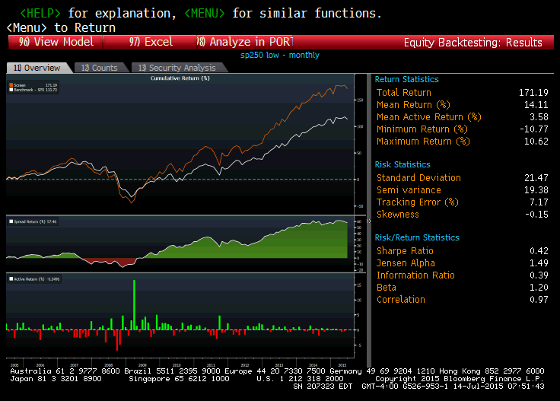
US ALGORITHM INDICES PLATFORM – SMART BETA: Work in progress
Universe | the stocks in the SPX that do not belong to Index 1
Nb of stocks | Number of stocks in SPX - Number of stocks in Index 1
Reshuffle | same rules as SPX
Weighting Methodology | Equi-Weighting
Reweighting | same rules as SPX
Dividend | Reinvested (net)
Synthetic Dividend | 3%
The S&P 500 story (brand) with a similar or better performance and structure products friendly pricing parameters
S&P 500 Large Bottom 250 Equal Weight Total Return Strategy
BACKTESTING

Slide 10
US ALGORITHM INDICES PLATFORM – RISK PREMIA : Examples of Asset Allocation
Dynamic Multifactor series
Natixis Dynamic Multi Factor US Equity Index
Natixis Dynamic Multi Factor Europe Equity Index
Momentum Investment on Risk Premia
Natixis MRP US Equity Strategy
Natixis MRP Europe Equity Strategy
Risk Premia Allocation Strategies
BUILDING AN ALLOCATION PORTFOLIO: FLAGSHIPS

Slide 11
US ALGORITHM INDICES PLATFORM – RISK PREMIA : Examples of Asset Allocation
Investment Strategy : MRP – Momentum on Risk Premia
Investment Objective: to outperform its underlying benchmark (S&P 500 Total return)
Dynamic exposition to the Risk Premia according to their past performances
Monthly rebalancing
Investment Universe composed of Natixis US Risk Premia building blocks & S&P 500 Total Return
Performance (computed from 01/29/1999 to 06/22/2015)
Past performances are neither an indicator nor a guarantee of future results.
 | MRP | SPXT
IRR | 15.41% | 5.08%
Stdev | 20.64% | 19.99%
Sharpe Ratio | 0.75 | 0.25
Max Drawdown | -52.90% | -55.25%
2013 Return | 38.33% | 32.39%
2014 Return | 15.70% | 13.69%
YTD Return | 4.04% | 8.87%

Slide 12
US ALGORITHM INDICES PLATFORM – RISK PREMIA : Examples of Asset Allocation
Investment Strategy : MRP Excess return – Momentum on Risk Premia Excess Return
Investment Objective: to allocate to the right US Equity Risk Premia Excess return
Dynamic exposition to the Risk Premia Excess Return according to their past performances
Excess Return defined by getting long the MRP and short the S&P 500 Total Return
Monthly rebalancing
Investment Universe composed of Natixis US Risk Premia building blocks & S&P 500 Total Return
Performance (computed from 01/29/1999 to 06/22/2015)
Past performances are neither an indicator nor a guarantee of future results.
 | MRP | SPXT
IRR | 15.41% | 5.08%
Stdev | 20.64% | 19.99%
Sharpe Ratio | 0.75 | 0.25
Max Drawdown | -52.90% | -55.25%
2013 Return | 38.33% | 32.39%
2014 Return | 15.70% | 13.69%
YTD Return | 4.04% | 8.87%

Slide 13
US ALGORITHM INDICES PLATFORM – RISK PREMIA : Alpha Generation
Risk Premia Alpha generation
Long Risk Premia beta adjusted
Short Benchmark
ABSOLUTE PERFORMANCE

Slide 14
US ALGORITHM INDICES PLATFORM – RISK PREMIA : Beta adjusted building blocks
Low Volatility beta adjusted
Natixis Low Volatility US Equity beta adjusted Strategy
Natixis Low Volatility Europe Equity beta adjusted Strategy
Natixis Low Volatility Russel 3000 beta adjusted Strategy
Value beta adjusted
Natixis Long Value US Equity beta adjusted Strategy
Natixis Long Value Europe Equity beta adjusted Strategy
Small Cap beta adjusted
Natixis Small Cap US Equity beta adjusted Strategy
Natixis Small Cap Europe Equity beta adjusted Strategy
High Dividend beta adjusted
Natixis High Dividend US Equity beta adjusted Strategy
Natixis High Dividend Europe Equity beta adjusted Strategy
Momentum beta adjusted
Natixis Momentum US Equity beta adjusted Strategy
Natixis Momentum Europe Equity beta adjusted Strategy
Risk Premia beta adjusted
ADJUST THE BETA TO BENCHMARK (leverage capped at 200% and floored at 50%)

Slide 15
US ALGORITHM INDICES PLATFORM – RISK PREMIA : Beta adjusted building blocks
US Equity Beta Adjusted Low volatility strategy

Slide 16
US ALGORITHM INDICES PLATFORM – RISK PREMIA : Alpha Generation
Long Low volatility beta adjusted and short benchmark

Slide 17
US ALGORITHM INDICES PLATFORM – IMPLIED ASSETS STRATEGIES
Risk Premia / Smart Beta
Buy Write
Multi Assets Allocation
Investment Thematic
Implied Assets

Slide 18
US ALGORITHM INDICES PLATFORM – IMPLIED ASSETS: OVERVIEW
Volatility Strategies
Long implied Volatility
Short implied Volatility
Long / Short implied volatility
Short implied vs realized
Diversification across Geographical areas
Europe
US
Asia
Diversification across Asset classes
Equity
FX
Fixed Income
Dividend Strategies
Long dividends
Dispersion Strategies
Long dispersion
A WHOLE RANGE TO BUILD

Slide 19
US ALGORITHM INDICES PLATFORM – IMPLIED ASSETS
Long Volatility
Long VIX Strategy
Long VSTOXX Strategy
Short Volatility
Short VIX Strategy
Short VSTOXX Strategy
Volatility Arbitrage
Long Short VIX Strategy
Long Short VSTOXX Strategy
Long Dividends
Long European Dividends
Implied assets
FLAGSHIPS

Slide 20
US ALGORITHM INDICES PLATFORM – IMPLIED ASSETS
Investment Strategy highlights
How to reduce VIX futures rolling costs whilst capturing major VIX spikes
Investment Universe:
SPVXSP (ST VIX futures) & SPVXMP (MT Vix Futures)
Long Only VIX exposures (between 0% and 100% exposure)
Focus on SPVXMT (SPVXST) when NXSHARPU=1,2 (3,4)
Daily increase (decrease) of exposure depending on rolling cost and trend following score
Historical Performance statistics
Backtesting charts
 | SPVXSTR Index | SPVXMTR Index | NXSDLVIX
IRR | -43.2% | -13.7% | 13.9%
stdev | 51.8% | 26.0% | 18.9%
Sharpe | (0.83) | (0.53) | 0.74
2014 | -25.53% | -16.5% | -6.9%
2013 | -65.75% | -43.8% | -2.7%
2012 | -77.94% | -52.9% | -6.3%
2011 | -3.78% | -7.7% | 2.5%
2010 | -72.03% | -13.3% | -2.0%
2009 | -64.95% | -23.7% | 7.6%
2008 | 123.11% | 81.2% | 158.2%
2007 | 36.61% | 47.1% | 36.6%
2006 | -46.85% | -17.3% | -1.1%
LONG ONLY DYNAMIC VIX STRATEGY

Slide 21
US ALGORITHM INDICES PLATFORM – IMPLIED ASSETS
Investment Strategy highlights
How to capture short VIX futures rolling gains whilst avoiding major VIX spikes
Investment Universe:
SPVXSP (ST VIX futures)
Short Only VIX exposures (between -25% and 0% exposure)
Daily increase (decrease) of short exposure depending on rolling gain and trend following score
Historical Performance statistics
Backtesting charts
 | SPVXSTR Index | short SPVXSTR | NXSDSVIX
IRR | -43.2% | 8.4% | 11.3%
stdev | 51.8% | 13.1% | 8.6%
Sharpe | (0.83) | 0.64 | 1.32
2014 | -25.53% | 1.6% | 0.0%
2013 | -65.75% | 24.1% | 5.5%
2012 | -77.94% | 33.9% | 26.9%
2011 | -3.78% | -8.4% | 9.3%
2010 | -72.03% | 29.7% | 21.1%
2009 | -64.95% | 24.4% | 19.9%
2008 | 123.11% | -23.6% | 1.9%
2007 | 36.61% | -13.0% | -2.7%
2006 | -46.85% | 13.9% | 13.5%
SHORT ONLY DYNAMIC VIX STRATEGY

Slide 22
US ALGORITHM INDICES PLATFORM – IMPLIED ASSETS
Investment Strategy highlights
Dynamic Long VIX future overlaid by dynamic short term VIX futures with lower exposure
Investment Universe:
Natixis Dynamic Long VIX futures and Dynamic Short VIX futures strategies
exposures between 0% and 100% on the Dynamic Long VIX futures
exposures between -10% and 0% on the Dynamic Short VIX futures
Historical Performance statistics
Backtesting charts
 | SPVXSTR Index | NXSDLVIX | SPXT Index | NXSDLSVIX
IRR | -43.7% | 15.4% | 7.6% | 21.4%
stdev | 52.7% | 19.6% | 18.0% | 19.9%
Sharpe | (0.83) | 0.78 | 0.42 | 1.08
2014 | -25.5% | -6.9% | 13.7% | -6.8%
2013 | -65.7% | -2.7% | 32.4% | 2.3%
2012 | -77.9% | -6.3% | 16.0% | 6.0%
2011 | -3.8% | 2.5% | 2.1% | 6.5%
2010 | -72.0% | -2.0% | 15.1% | 6.0%
2009 | -65.0% | 7.6% | 26.5% | 16.7%
2008 | 123.1% | 158.2% | -37.0% | 157.4%
2007 | 36.6% | 36.6% | 5.5% | 36.1%
2006 | -27.9% | 0.0% | 5.3% | 3.2%
LONG BIAS DYNAMIC VIX STRATEGY

Slide 23
US ALGORITHM INDICES PLATFORM – IMPLIED ASSETS
LONG VSTOXX STRATEGY

Slide 24
US ALGORITHM INDICES PLATFORM – IMPLIED ASSETS
SHORT VSTOXX STRATEGY

Slide 25
US ALGORITHM INDICES PLATFORM – IMPLIED ASSETS
LONG BIAS VSTOXX STRATEGY

Slide 26
US ALGORITHM INDICES PLATFORM – IMPLIED ASSETS: VOLATILITY OVERLAY
Volatility overlay of an Equity Portfolio
Long Equity Portfolio
Long Volatility strategy
IMPLIED VOLATILITY AS A DIVERSIFIER OF A LONG BETA PORTFOLIO

Slide 27
US ALGORITHM INDICES PLATFORM – IMPLIED ASSETS: HOW TO BUILD A PORTFOLIO COMPOSED OF EQUITY AND IMPLIED VOLATILITY
Implied volatility is a true diversifier of an Equity Portfolio
Allocation table
NXSHARPU Index | SPXT weight | Natixis VIXLS Weight
1 | 90.0% | 10.0%
2 | 70.0% | 30.0%
3 | 50.0% | 50.0%
4 | 30.0% | 70.0%
Historical Performance statistics
 | SPXT Index | SPXT Index + Vol
IRR | 7.6% | 21.2%
stdev | 18.0% | 12.3%
Sharpe | 0.42 | 1.72
2014 | 13.69% | 6.7%
2013 | 32.39% | 26.6%
2012 | 16.00% | 11.4%
2011 | 2.11% | 4.5%
2010 | 15.06% | 13.5%
2009 | 26.46% | 27.8%
2008 | -37.00% | 76.8%
2007 | 5.49% | 18.1%
2006 | 5.27% | 5.1%
Backtesting charts
BETTER RISK ADJUSTED RETURNS COMPARED TO BENCHMARK

Slide 28
US ALGORITHM INDICES PLATFORM – BUY WRITE STRATEGIES STRATEGIES
Risk Premia / Smart Beta
Buy Write
Multi Assets Allocation
Investment Thematic
Implied Assets

Slide 29
US ALGORITHM INDICES PLATFORM – BUY WRITE: OVERVIEW
Call overwriting strategy enhancement
Option expiries
Option strikes
Option notional
Stop losses
Diversification across Geographical areas
Europe
US
Asia
HOW TO MITIGATE THE DRAWDOWN OF A LONG BETA EXPOSURE

Slide 30
US ALGORITHM INDICES PLATFORM – BUY WRITE
US Equity buy write series
Long US equity portfolio / call overwriting / put underwriting
S&P 500 as underlying for call and Put options
EURO Equity buy write series
Long Euro equity portfolio / call overwriting / put underwriting
SX5E as underlying for call and Put options
Japan Equity buy write series
Long JPY equity portfolio / call overwriting / put underwriting
Nikkei 225 as underlying for call and Put options
Honk Kong Equity buy write series
Long HKD equity portfolio / call overwriting / put underwriting
HSI as underlying for call and Put options
Buy Write
TARGET BUY WRITE RANGE

Slide 31
US ALGORITHM INDICES PLATFORM – BUY WRITE
Investment Strategy
d
LONG US EQUITY PORTFOLIO AND SYSTEMATIC CALL OVERWRITING
Performance (computed from 01/03/2006 to 04/30/2015)
Past performances are neither an indicator nor a guarantee of future results.
 | SPX | SPX + Overlay 102.5% | SPX + Overlay Delta 25%
IRR | 5.47% | 9.43% | 8.55%
Volatility | 21.04% | 17.71% | 18.46%
Sharpe Ratio | 0.26 | 0.53 | 0.46
Max Drawdown | - | - | -
2013 Return | 29.60% | 25.22% | 22.03%
2014 Return | 11.39% | 8.83% | 8.79%
YTD Return | 3.98% | 5.62% | 7.51%

Slide 32
US ALGORITHM INDICES PLATFORM – BUY WRITE
Investment Strategy
Dynamic exposition to the Risk Premia according to their past performances
Without Risk Premia Momentum
LONG LOW RISK PORTFOLIO OF US EQUITY AND SYSTEMATIC CALL OVERWRITING
Performance (computed from 01/29/1999 to 06/22/2015)
Past performances are neither an indicator nor a guarantee of future results.

Slide 33
US ALGORITHM INDICES PLATFORM – INVESTMENT THEMATIC STRATEGIES
Risk Premia / Smart Beta
Buy Write
Multi Assets Allocation
Investment Thematic
Implied Assets

Slide 34
US ALGORITHM INDICES PLATFORM – INVESTMENT THEMATIC: OVERVIEW
Activism
Natixis partnership with Lutecia
Buyback
Europe
US
Asia
SRI
Europe
US
Asia
INCREASE GRADUALLY THE INVESTMENT THEMES

Slide 35
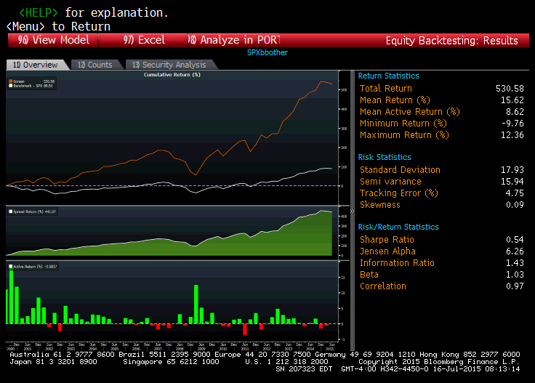
US ALGORITHM INDICES PLATFORM – INVESTMENT THEMATIC: BUYBACK
Investment Strategy highlights
Investment Universe:
members of S&P 500
1st filter based on buyback score
2nd filter based on free cash flow yield score
Ponderation : equiweighted
Rebalancing frequency: monthly
BUYBACK US EQUITY STRATEGY

Slide 36
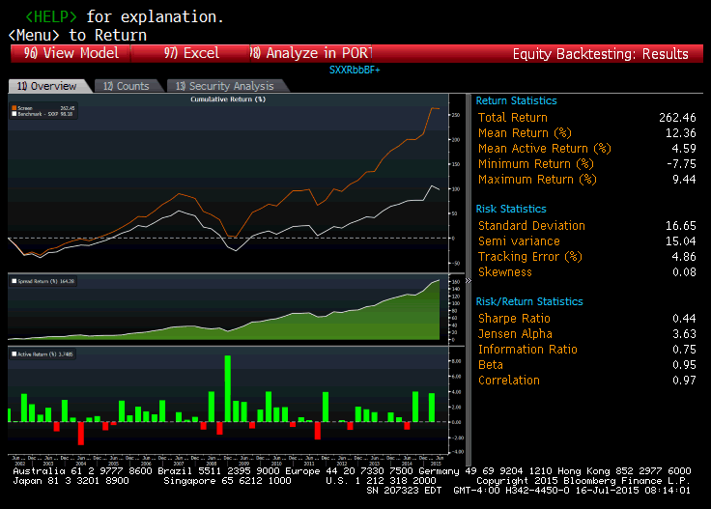
US ALGORITHM INDICES PLATFORM – INVESTMENT THEMATIC: BUYBACK
Investment Strategy highlights
Investment Universe:
members of STOXX 600 EUROPE
1st filter based on buyback score
2nd filter based on free cash flow yield score
Ponderation : equiweighted
Rebalancing frequency: monthly
BUYBACK EUR EQUITY STRATEGY

Slide 37
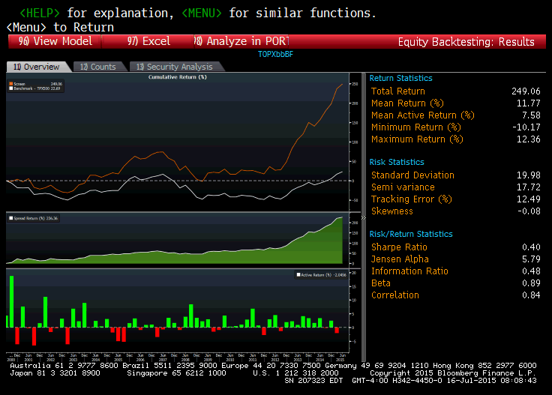
US ALGORITHM INDICES PLATFORM – INVESTMENT THEMATIC: BUYBACK
Investment Strategy highlights
Investment Universe:
members of TOPIX 500
1st filter based on buyback score
2nd filter based on free cash flow yield score
Ponderation : equiweighted
Rebalancing frequency: monthly
BUYBACK JAPAN EQUITY STRATEGY

Slide 38
US ALGORITHM INDICES PLATFORM – INVESTMENT THEMATIC
NATIXIS ACTIVISM STRATEGY with LUTECIA

Slide 39
US ALGORITHM INDICES PLATFORM – MULTI ASSET ALLOCATION
Risk Premia / Smart Beta
Buy Write
Multi Assets Allocation
Investment Thematic
Implied Assets

Slide 40
US ALGORITHM INDICES PLATFORM – MULTI ASSET ALLOCATION: OVERVIEW
Flexible Allocation: Bond and Equity
NXS SHARPe US Equity Index
NXS SHARPe Euro Equity Index
NXS SHARPe Japan Equity Index
NXS SHARPe Hong Kong Equity Index
Wilshire Dynamic Vol Model For Natixis
AlphaSimplex For Natixis
Multi asset classes allocation
NXS SHARPe Multi Asset Worldwide EUR
NXS SHARPe Multi Asset Worldwide USD
NXS SHARPe Evolution
NXS STARS Multi Asset
NXS SHARPe Euro Diversified
INCREASE GRADUALLY THE INVESTMENT THEMES

Slide 41
Overview of Solution Structure
Strategic Partnership
How the partnership can work:
The custom-designed Wilshire index will be packaged into an indexed annuity product that can be sold to insurers as a co-branded product.
Natixis will manage the derivative exposure on the products, which will involve dynamic hedging on a proxy portfolio that directly replicates the aggregate exposures generated by the Wilshire index (or indices) embedded in the product.
Licensing and Legal Considerations:
An exclusive licensing agreement will bind the parties
Wilshire would be referred to as the Index Sponsor and would also serve as the calculation agent for the index

Slide 42
Overview of Solution Structure
Construction of the Wilshire Dynamic Volatility Strategy
Regime Forecasting Indicator
Market Sentiment Indicator
Normal Regime
Crisis Regime
High Volatility Regime
Probability 1
Probability 2
Probability 3
Wilshire Dynamic Volatility
Strategy Allocation

Slide 43
Overview of Solution Structure
Wilshire Market Sentiment Indicator
Liquid and Well-Known Underlyings used for the Allocations
The two underlyings used in executing the strategy are listed in the table below:
 | Ticker | Name
Safe Asset | SPY US Equity | SPDR S&P 500 ETF Trust
Risky Asset | AGG US Equity | iShares Core U.S. Aggregate Bond ETF

Slide 44
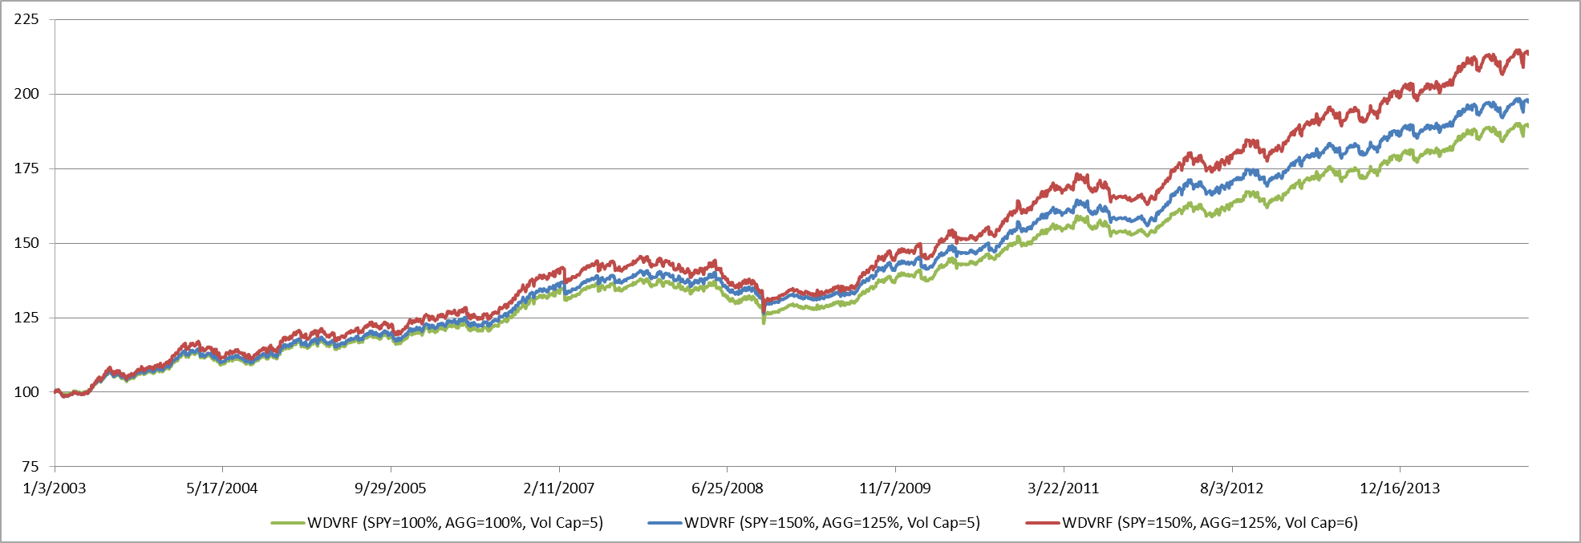
US ALGORITHM INDICES PLATFORM – MULTI ASSET ALLOCATION
* Source: Wilshire. The performance shown reflects simulated performance, and is shown gross of fees and transaction costs. The performance does not reflect invested accounts.
Simulated performance is not indicative of future results. Actual future performance results may vary
WILSHIRE DYNAMIC VOLATILITY MODEL

Slide 45
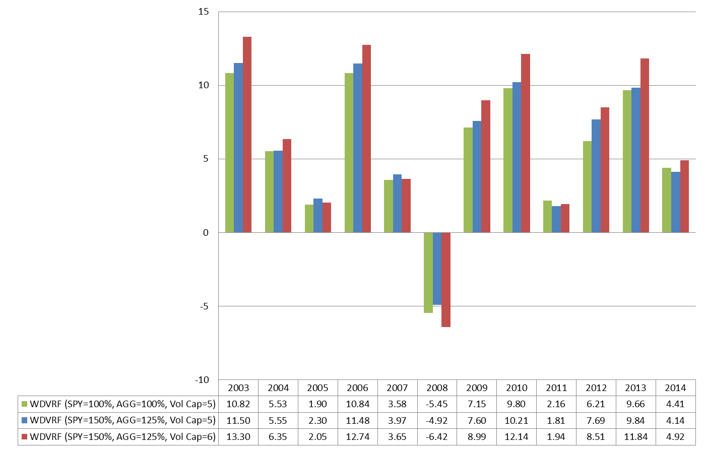
Product Backtesting
Calendar Year Returns*
* Source: Wilshire. The performance shown reflects simulated performance, and is shown gross of fees and transaction costs. The performance does not reflect invested accounts.
Simulated performance is not indicative of future results. Actual future performance results may vary

Slide 46
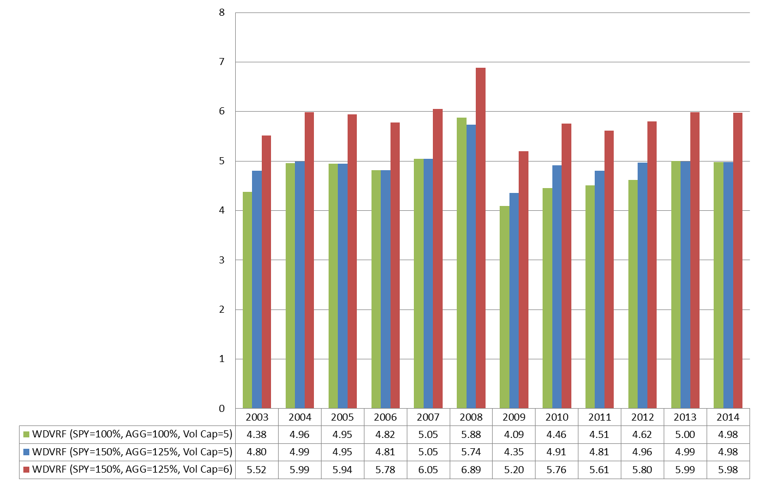
Product Backtesting
Calendar Year Risk Based on Daily Returns*
* Source: Wilshire. The risk shown reflects simulated results, and does not reflect invested accounts. Simulated risk is not indicative of future risk. Actual future results may vary.

Slide 47
US ALGORITHM INDICES PLATFORM – NEXT STEPS
Systems
Caesar Indice
Data base: PRISM
Processes
NPC Natixis Americas
Regulatory documentation check ( 3(a)(2) & Offshore, disclaimers, etc…)
Index rules production and validation
Trading, legal and financial engineering coordination
Strategy ideas generation
Index launching process
Marketing
Internal communication with sales
Marketing pitch approved for institutional investors
Reporting
Online performance update
Monthly performance explanation
“ Breaking News ” type of communication impacting the performance
Platform
Expand toward a multi asset platform

